Slide 1
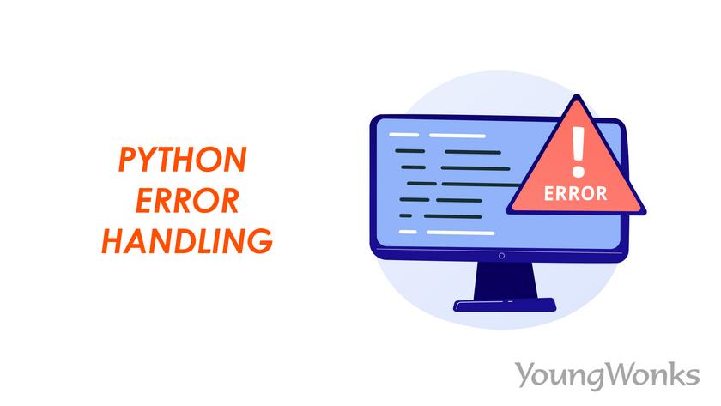

Slide 2
Error handling is the process of managing and responding to runtime errors in a program to prevent it from crashing unexpectedly. Instead of allowing the program to stop, we catch errors and handle them gracefully using techniques like try-except blocks.
Why?
Prevents program crashes – Without error handling, the program stops execution when an error occurs.
Improves user experience – Provides meaningful error messages instead of cryptic system errors.
Ensures data integrity – Prevents data corruption due to unexpected failures.
Makes debugging easier – Helps track down and log errors for fixing.
Maintains system reliability – Especially in critical applications like banking and healthcare.

Slide 3
try:
age=int(input("Enter the age"))
print(f"Your age is {age}")
except ValueError:
print("Error: Enter the number Format only")
import pandas as pd
try:
df=pd.read_json(r"C:\Users\nagal\Downloads\data .json")
print(df)
except FileNotFoundError:
print("Error: The file was not found")

Slide 4
import pandas as pd
try:
df=pd.read_csv(r"C:\Users\nagal\Downloads\text.txt",delimiter='\t')
if df.empty:
raise ValueError("Error: The file has no data to display")
print(df)
except ValueError as e:
print("Error: The file is completely empty")
Custom Raise Exception

Slide 5
#Custom raise Exception based on condition
try:
df=pd.read_csv(r"c:\Users\nagal\oneDrive\Desktop\data Analysis\Tableau\new_york.csv")
if df['price'].isnull().any():
raise ValueError("❌ Error: Missing values found in the 'price' column!")
print("✅ Price column is valid!")
except ValueError as e:
print(e)

Slide 6
Finally
The finally block in Python is used to execute cleanup operations, whether an exception occurs or not. This is especially useful for closing files, database connections, or releasing resources.
try:
file=open(r"C:\Users\nagal\Downloads\text1.txt")
data=file.read()
print("File read sucessfully")
print(data)
except FileNotFoundError:
print("Error:File not found")
finally:
file.close()
print("File Closed")

Slide 7
BaseException
├── SystemExit (Raised when sys.exit() is called)
├── KeyboardInterrupt (Raised when user interrupts program, e.g., Ctrl+C)
├── Exception (Base class for most exceptions)
├── ArithmeticError
│ ├── ZeroDivisionError (Division by zero)
│ ├── OverflowError (Number too large)
│ ├── FloatingPointError (Floating point error)
├── LookupError
│ ├── IndexError (List/tuple index out of range)
│ ├── KeyError (Dictionary key not found)

Slide 8
├── FileNotFoundError (File does not exist)
├── ValueError (Incorrect value type)
├── TypeError (Wrong data type used)
├── AttributeError (Accessing an invalid attribute)
├── ImportError (Module import fails)
├── EOFError (Unexpected end of input)

Slide 9
Context Manager
A context manager is a tool in Python that helps manage resources automatically. It ensures that resources like files, databases, or network connections are properly opened and closed without manual handling.
try:
with open(r"C:\Users\nagal\OneDrive\Desktop\Data Analysis\Tableau\new_york.csv")as csv:
content=csv.read()
print(content)
print("🔹 Inside 'with' block: Is file closed?", csv.closed)
except FileNotFoundError:
print("Error: The file not found")
print("✅ Outside 'with' block: Is file closed?", csv.closed)

Slide 10
Two ways to define Custom Context manager:
Using class, enter and exit.
Using Contextlib
Custom Context Manager

